Slide 1


Slide 2


Description
Our project is restaurant management system, where we provide all the details that a manager needs to run the restaurant from ordering the food to generating bill and payment. In our project only a manager have authorization.
We have table customers for customer information, menu for list of food, tables through which a customer is assigned a table, orders and waiter table to take and manage orders. We also manage no. of people which are together to generate a common bill for all food ordered by them.
We allocate table based on vacancy status and an unoccupied waiter does that job for serving food to the customers. After a customer entered their information then we display menu for them to order.
Also, we keep a record of the waiters, like name, gender, salary etc. Menu is displayed with name of the dish and its price. We have unique dish ID to uniquely manage the orders.
And we generate bill automatically based on their order.

Slide 3
USER STORY
Restaurant Manager
Manager should be able to update information about restaurant.
Manager should be able to view info about waiters and customers.
Customer
Customers should be able to browse through the menu and look at the various food options available in the restaurant along with the price for each item.
Customer should be able to select items from the menu and add them to order.
Waiter
Waiters should be able to view the current queue to see the ready orders for pickup
Waiter should be able to serve orders to customers assigned to them

Slide 4
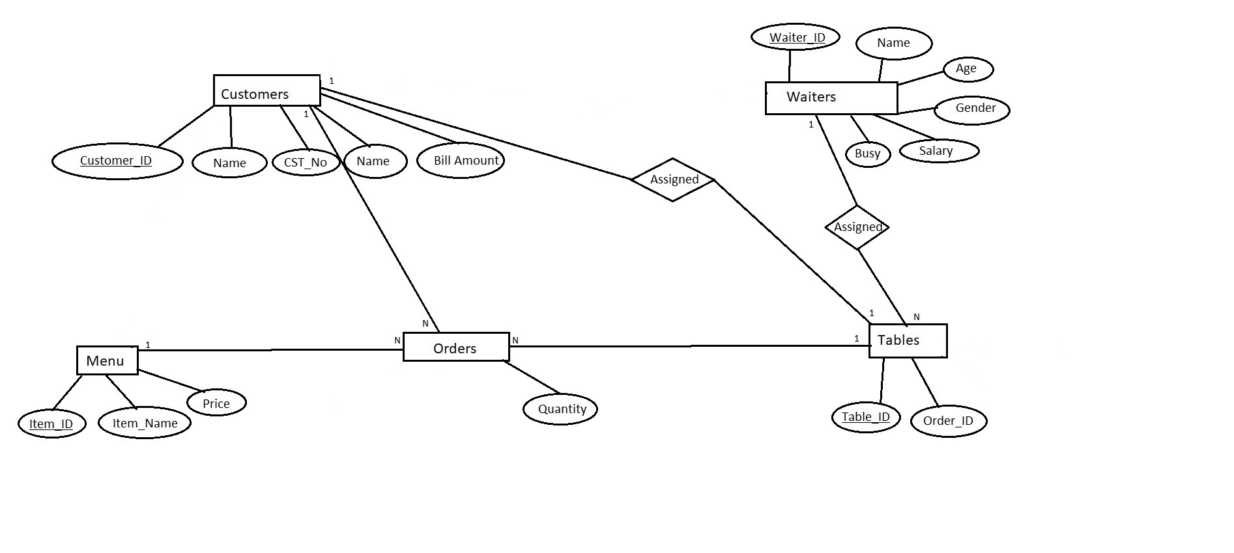
E-R DIAGRAM
An E-R diagram is used to represent the E-R model. It contains all known entities for the given scenario, their attributes, identifiers, and the relationships that exist among the entities.
As seen in figure the ER diagram has five entities which are made up of various attributes including the entity’s primary key and other attributes like the name, salary, age etc.

Slide 5
Database Schema and Tables
WAITER Table: -Waiter_ID attribute is a primary key to uniquely determine a waiter with Name, Age, Gender, Salary, Busy (with check constraint) as other attributes.
TABLES Table: - TABLE_ID attribute as primary key with Order_ID , WTR_ID for waiter ID, Customer_ID to determine customer on a particular table and , (WTR_ID) as FOREIGN KEY references (WTR_ID) of table waiter.
ORDERS Table: - ITEM_ID, Customer_ID , Quantity for quantity of items and (CUSTOMER_ID) FOREIGN KEY references (CUSTOMER_ID) of table customers.
CUSTOMERS Table: - CUSTOMER_ID as PRIMARY KEY to uniquely determine a customer, NAME CST_NO to determine the number of people along, TABLE_ID, BILL_AMOUNT containing total bill amount for customers and (TABLE_ID) as FOREIGN KEY references (TABLE_ID) of table TABLES.
MENU Table: - ITEM_ID as primary key to uniquely determine Item from menu , ITEM_NAME, PRICE as other attributes.

Slide 6
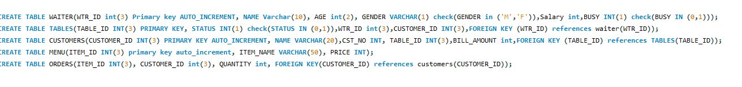
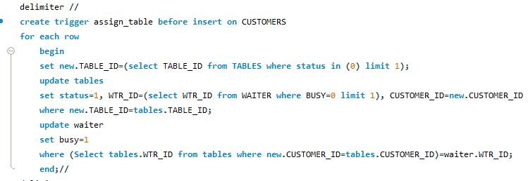
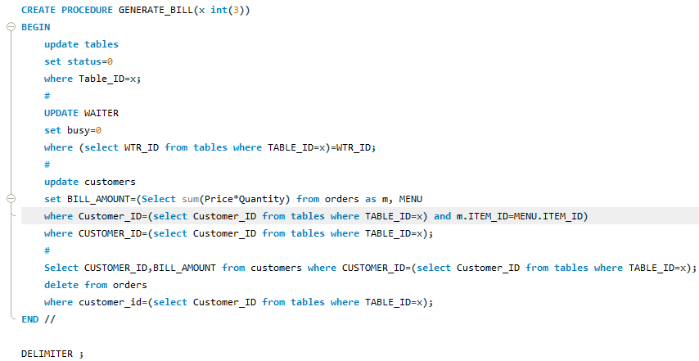
The Creation of database is shown below, which shows the tables created with the necessary constraints applied. Trigger assign_table is created to assign table to the new customer and assign an unoccupied waiter to serve. Procedure GENERATE_BILL is created to generate the bill for the customers order after ordering the food from the menu.

Slide 7
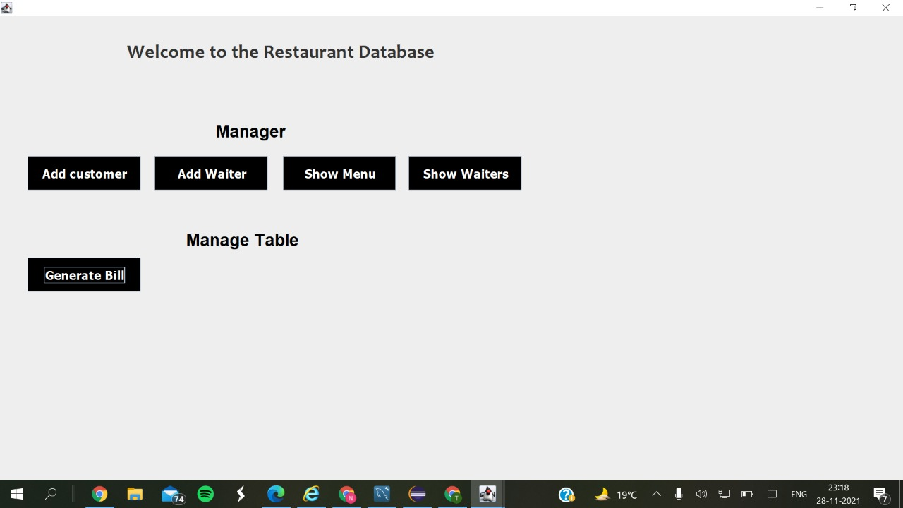
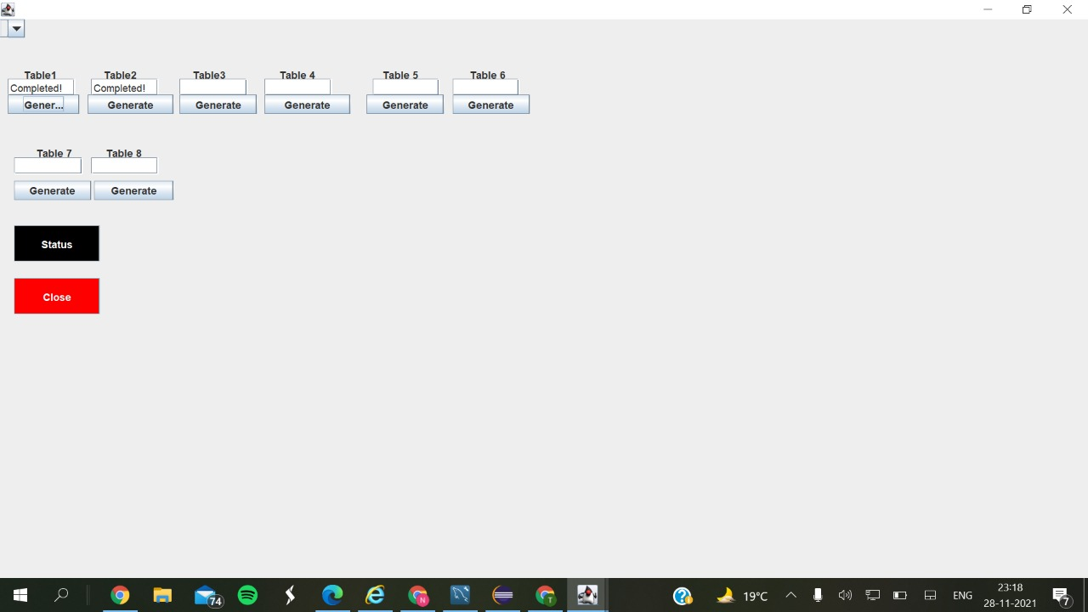
GUI SCREEN DISPLAY
Database Home Page Table Information Screen

Slide 8
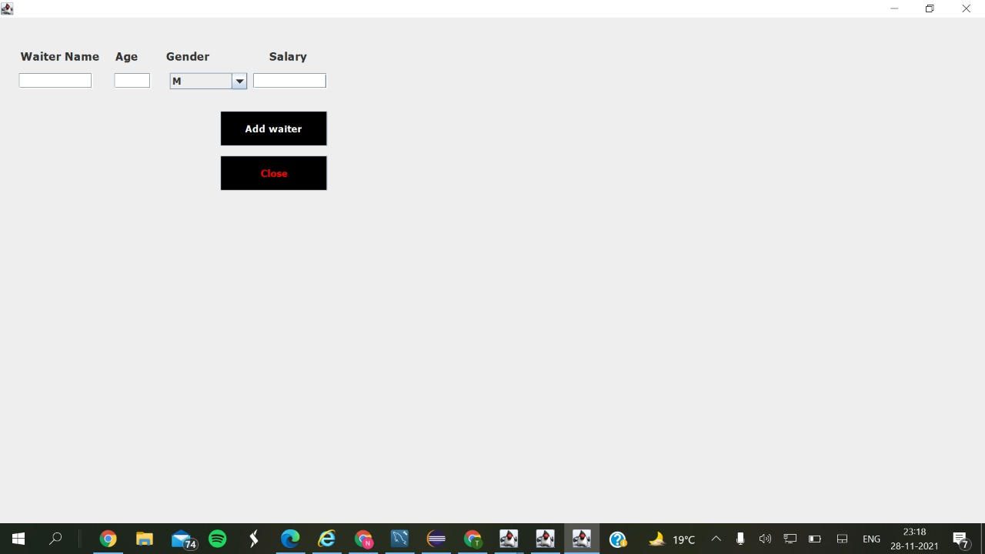
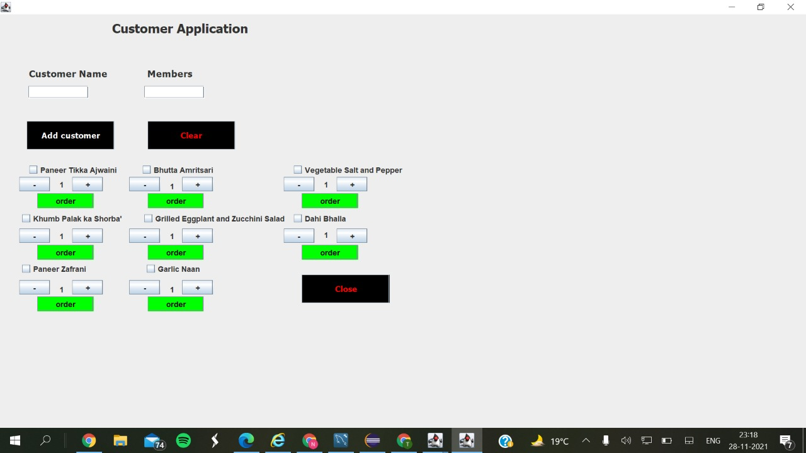
GUI SCREEN DISPLAY
For Adding WAITER For Customer Application

Slide 9
Java Classes And Applications Used are:
Java database connectivity (JDBC) is the JavaSoft specification of a standard application programming interface (API) that allows Java programs to access database management systems.
GUI (Graphical User Interface) in Java is an easy-to-use visual experience builder for Java applications.
DBtablePrinter CLASS
MySQL

Slide 10
GROUP NO. 12 TEAM MEMBERS 20UCS111 Manav Jangid 20UCS122 Jain Naman Ramesh 20UCS125 Naman Jain 20UCS149 Priyadarshini Sankar

